Slide 1

Orleton flood resilience scheme
2024-7
Presentation by Cllr David Lane
Former Principal Policy Advisor OFWAT and Senior Analyst - sewer flooding in England and Wales

Slide 2
Why are we talking about flooding?
A £1.2m grant has been obtained by Herefordshire Council to address surface water run-off which will be managed by the Severn Rivers Trust and include the area above Orleton
Herefordshire Council has announced a new grant available to parish councils to address surface water flooding on the highway
The EA is developing new guidance for riparian owners to encourage the maintenance of watercourses

Slide 3
The three elements of the Orleton Flood Resilience Scheme
Upstream – to retain floodwater, slowing the speed at which it enters Brimfield Brook – Severn Rivers Trust/Cllr Dan Hurcomb
In Orleton – outline scheme proposal to rebalance flows around the village to improve highway drainage and reduce flooding – Orleton Parish Council/Highways Agency/Herefordshire Council
Downstream – to use the models developed by the Environment Agency to encourage best practice in watercourse management

Slide 4
The cause of highway flooding at the Maidenhead Junction and Millbrook Way
Highway flooding occurs where more that 21mm of rain falls in 24hrs
Where existing gullies are overwhelmed with sediment and debris from field run-off from saturated ground.
Where the storm return period exceeds 1:15 years
Where Brimfield Brook river gauge exceeds 0.57m

Slide 5
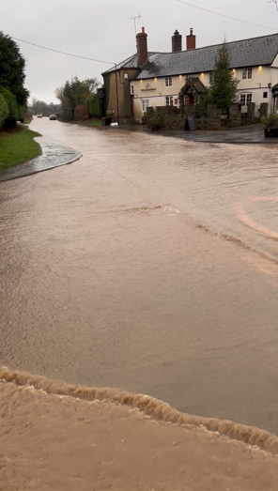
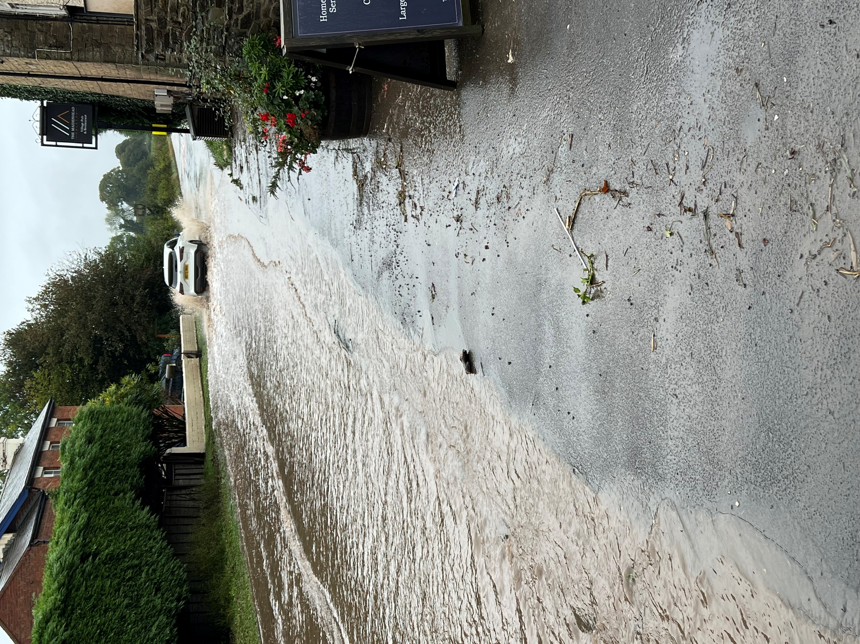
The Maidenhead junction – October 2023

Slide 6
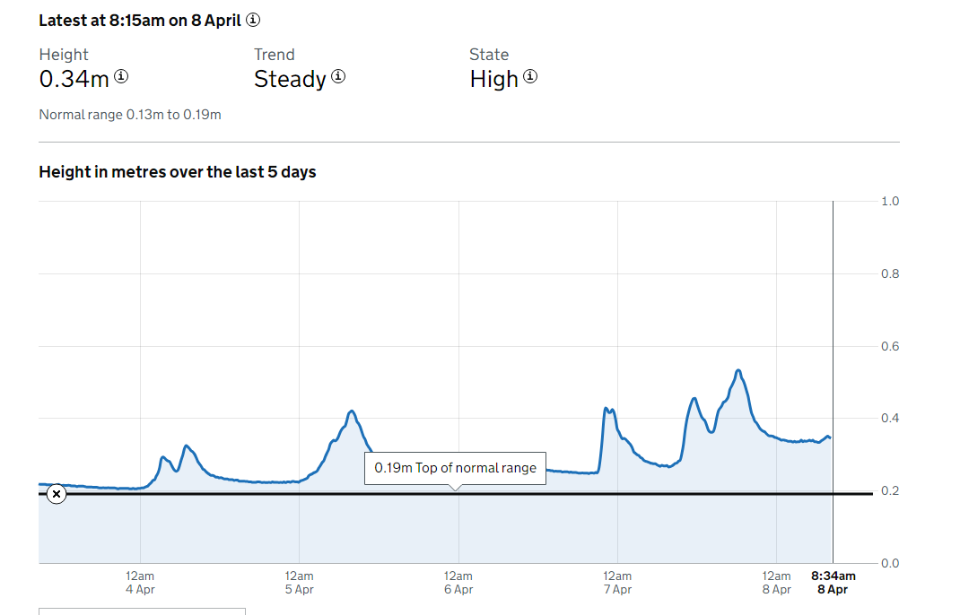
Typical patterns of storm flow

Slide 7
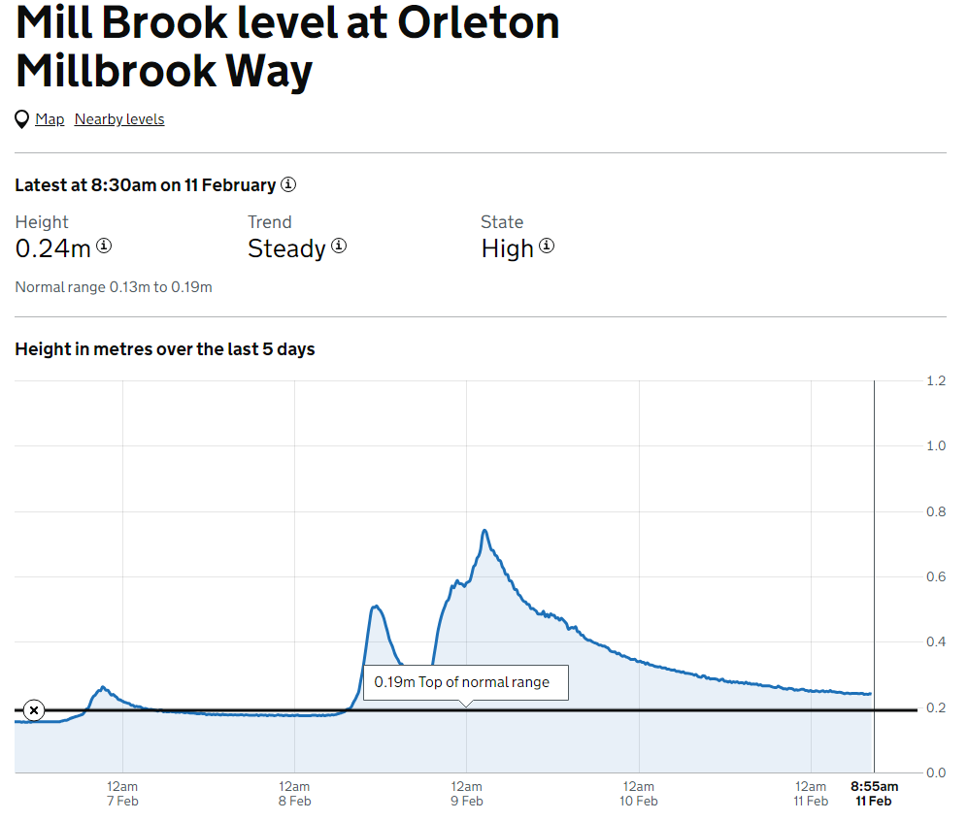
Storm Ciara profile – 9th February 2024

Slide 8
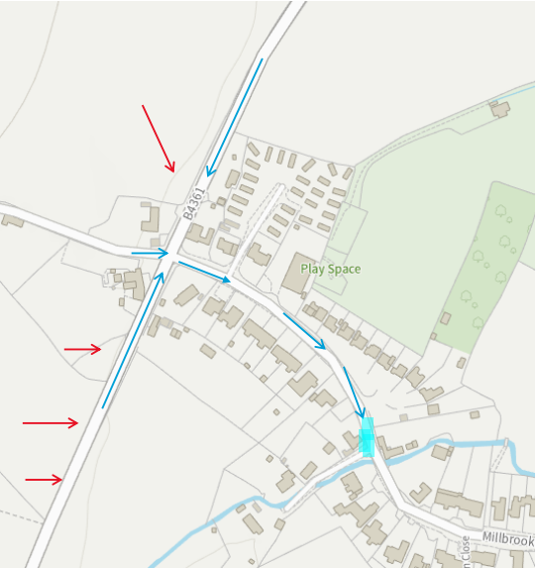
The existing flow map

Slide 9
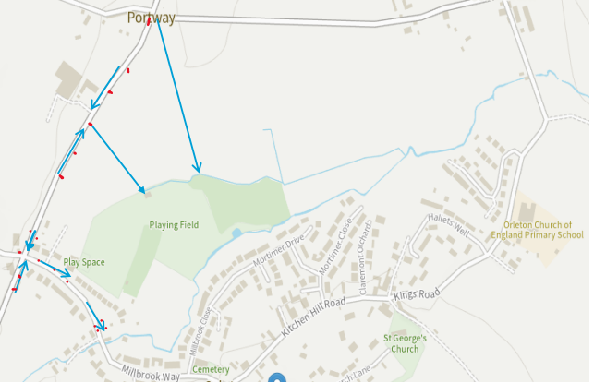
The existing highway drainage provision

Slide 10
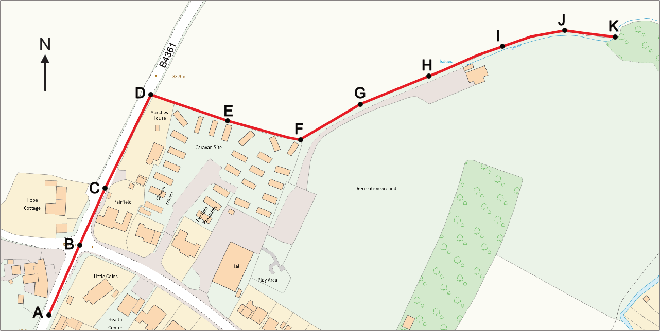
Changes to the B4361 highway drainage – Maidenhead junction

Slide 11
Objectives -
To remove four residential and one commercial property from high risk of internal flooding from the highway.
To remove seven residential properties from high risk of external flooding from the highway.
To reduce the frequency and severity of highway flooding in Millbrook Way.
To reduce the social and economic impact of flooding on Orleton Village.
To improve the performance of highway drainage within the village and reduce the risk of external flooding to property in the low-lying areas of Millbrook Close and Mortimer Drive.

Slide 12
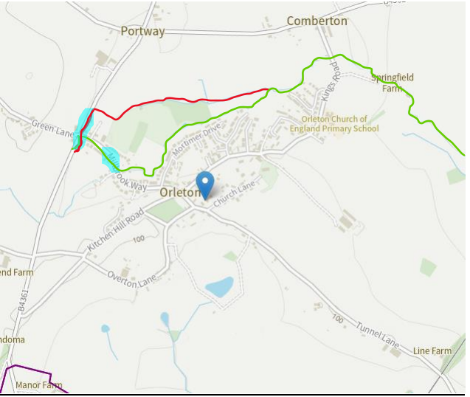
The outline proposal to rebalance flows

Slide 13
Providing a buffer against flash flooding
Millbrook Way | Diversion ditch (430m long 2m x 2m)
Storage area before re-entry in to brook 829m2 | Dry weather flood capacity 1720m3
Flood capacity before re-entry in to brook 126m3 | Wet weather flood capacity 860m3
Outlet pipe size 2 x 225mm = 450mm | Outlet pipe size 300mm
Fill time on average 20min

Slide 14
What happens next?
Herefordshire Highways will review the outline proposal and consider the viability risks/benefits and likely cost of the scheme.
The Highways Authority will be asked to engage in discussions regarding the defective drainage at the Maidenhead Junction and Millbrook Way with a view to their undertaking this scheme in a collaborative project.
The parish council will engage with the various stakeholders with specific and detailed drainage proposals for approval.
A grant application will be submitted for funds to carry out the necessary work to complete the pipework across agricultural land.
If agreement can be reached a joint project involving the Parish Council/Herefordshire Council and Highways Authority will need to be undertaken to examine the scheme scope, design, and management of the final project and draw up the necessary consents.

Slide 15
The risks – what can possibly go wrong…
Financial risk – too expensive
Technical risk – it proves impractical or too complex
Performance risk – it fails to deliver required improvements or results in flood displacement
Grant funding – if the application is refused or the grant is insufficient
Consent to lay pipes on third party land – permission is refused or there are practical or legal impediments
Highways Authority – refusal to undertake works on the highway and the parish has no legal authority to do so.

Slide 16
The people who are helping:
ORA – we welcome the engagement of the Chair and committee in continuing to develop this scheme.
Ena Sparey and Rob and Carol Morgan of Portway Farm who have indicated their support for this scheme and for their help in clearing ditches and offering equipment for this project.
To County Cllr Dan Hurcomb for agreeing to support and promote this scheme and to Herefordshire Council for their potential grant funding scheme.
To Mark Wetton who has leant his knowledge and professional expertise to this project in profiling the land and contributing to the development of the scheme.

Slide 17
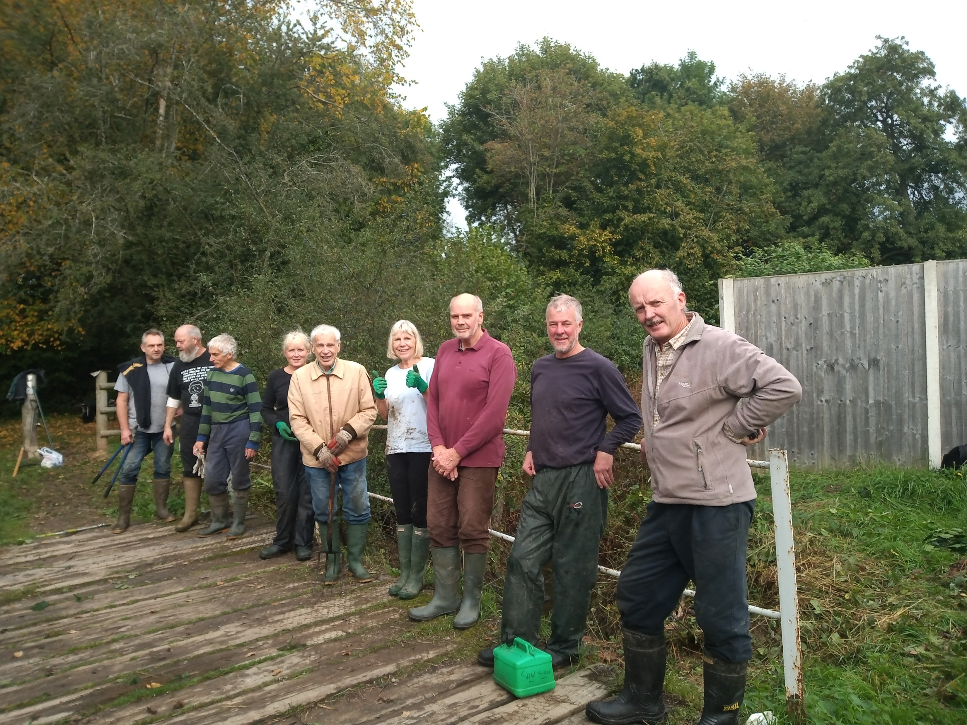
And finally…thanks to the Land Drainage Volunteers who make it all possible

